Slide 1
Using Machine Learning to Predict Citation Metrics
Bercin Cenik & Tina Huang

Slide 2

Qualifications for a job in academic science
Funding status
Commitment to research
Commitment to teaching
Educational background
…publications
In a scholarly journal
Peer-reviewed
High-impact

Slide 3
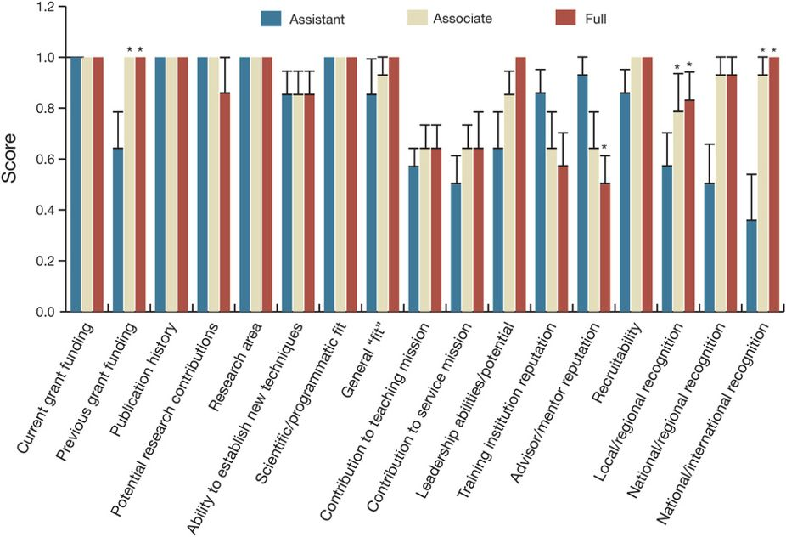

Slide 4
Citation impact quantifies the citation usage of scholarly works
Citation counts for an author, an individual article, or a publication

Slide 5





Websites that generate citation metrics

Slide 6

How many times will my article be cited?
…if it is published in <insert favorite journal here>

Slide 7
“So, how many times will my paper be cited?”
Project Goals
Acquire citation metrics from web of science
2000 – 2017
Nature Reviews Genetics
Title, authors, publication year, citation count (total and individual years)
Visualization of citation metrics
Use machine learning to predict citation counts for individual articles
Title of the article
Publication year
Name of senior author

Slide 8
Results can be downloaded as an .xls file
For our analyses, this was reformatted as a csv and cleaned up with pandas
Visualizations were generated with matplotlib

Slide 9
Summary (and fun facts)
3121 articles published between 2000 and 2017
The highest cited paper was cited >5000 times
On average, a NRG paper is cited 115 times
Half of the dataset had no citations

Slide 10
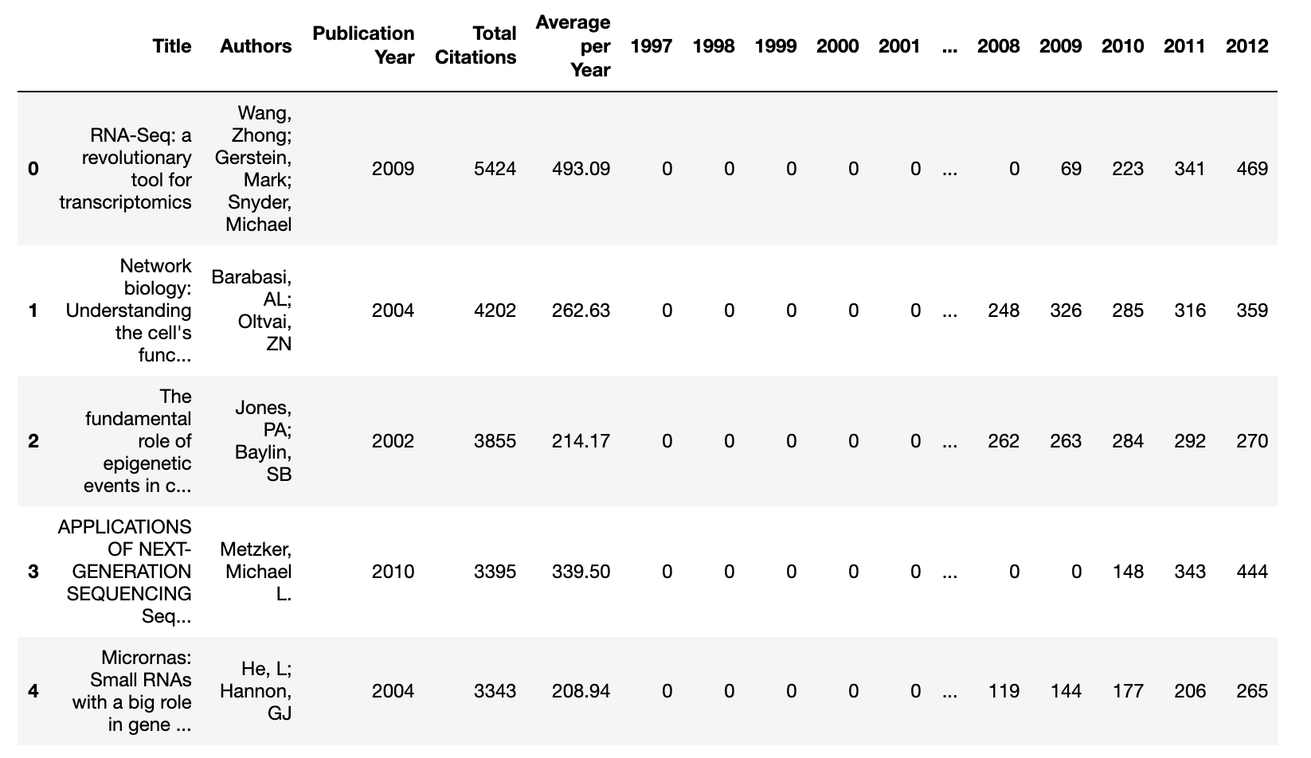
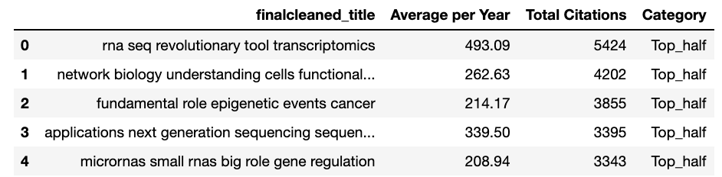
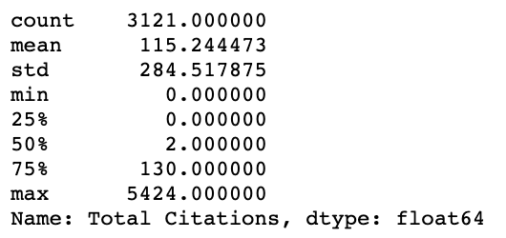
Goal
To predict whether a paper has above- or below-median total citation count based on its:
Title
Authors

Slide 11
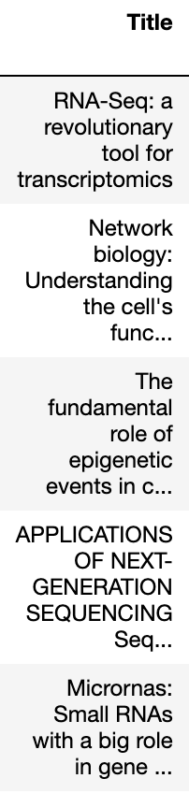
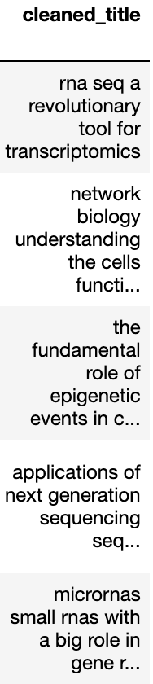
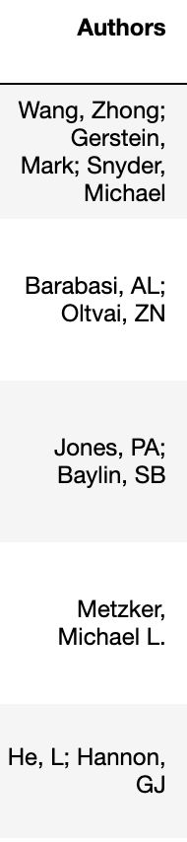

Tokenization

Slide 12
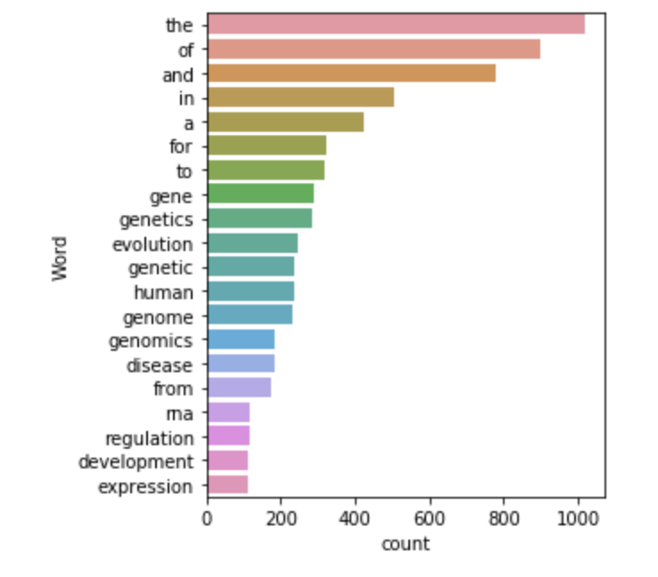
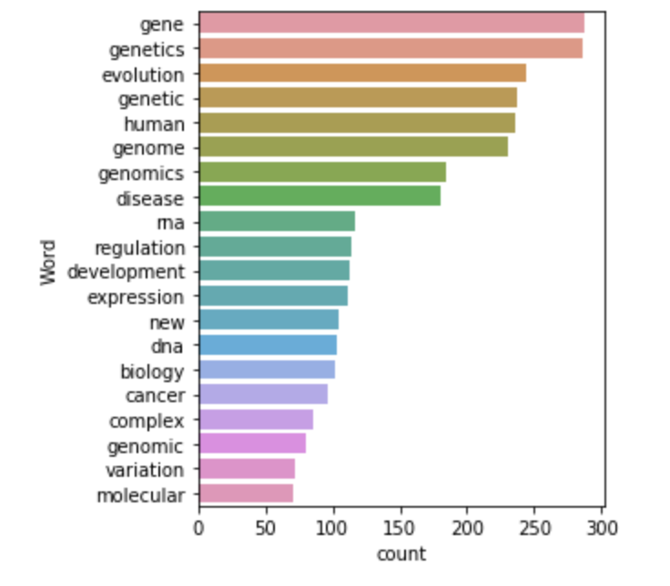
Stopwords
filtering

Slide 13
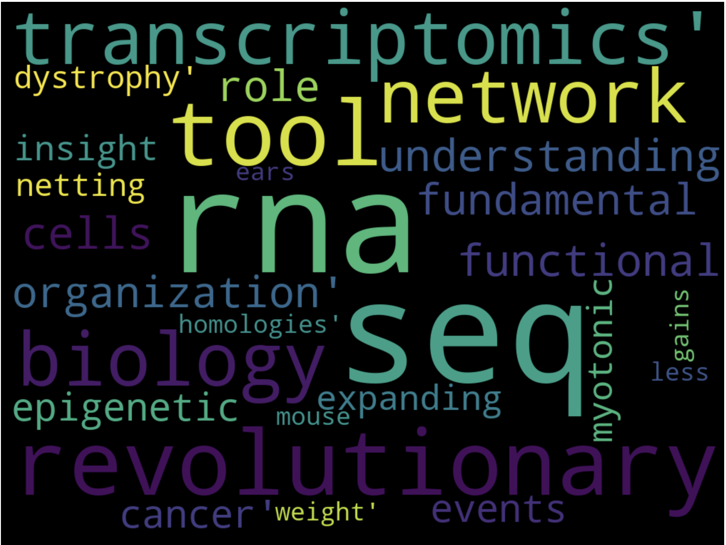
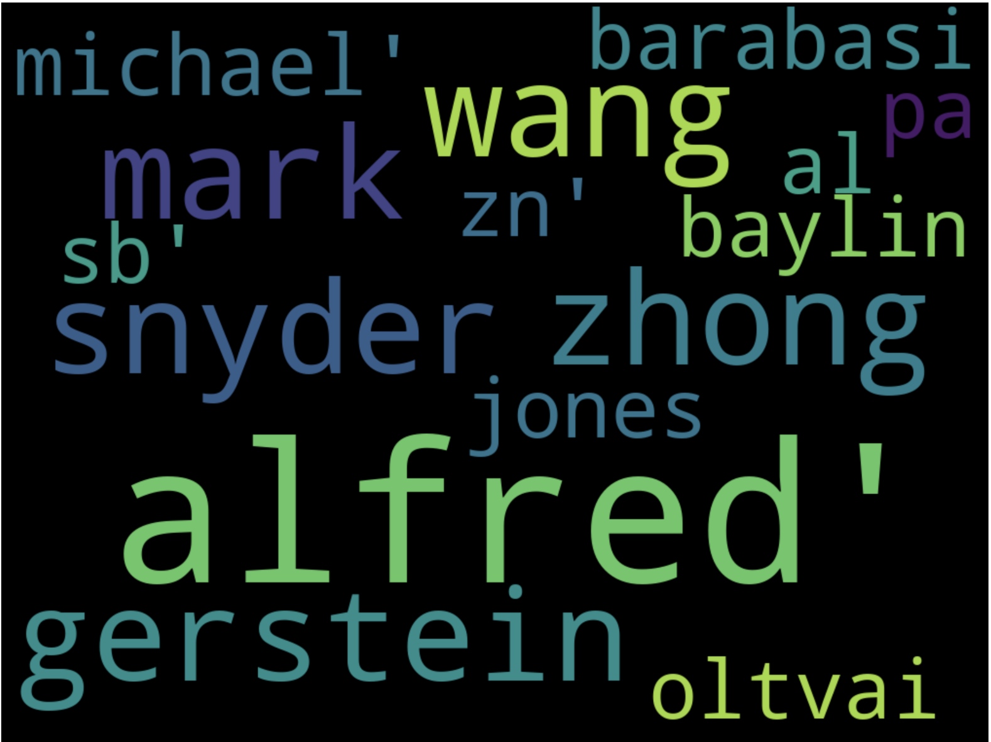
Most frequent words
Title
Author

Slide 14
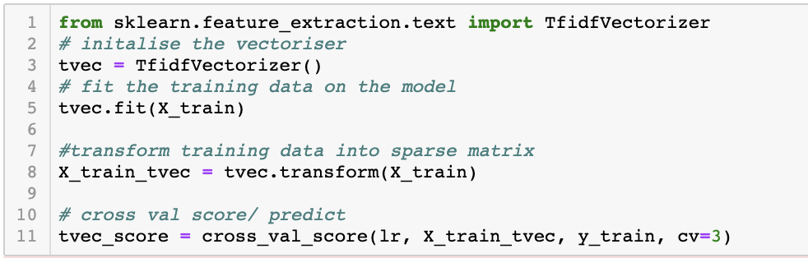
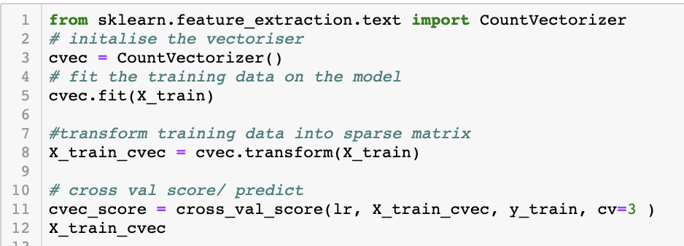
TF-IDF vs. Count Vectorizer
TF-IDF: weights down common words, gives more importance to rare words
Count Vectorizer: count the number of words

Slide 15
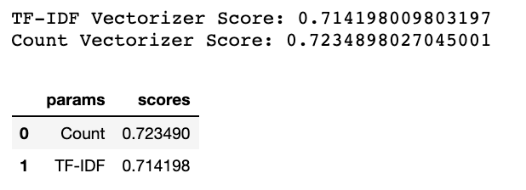
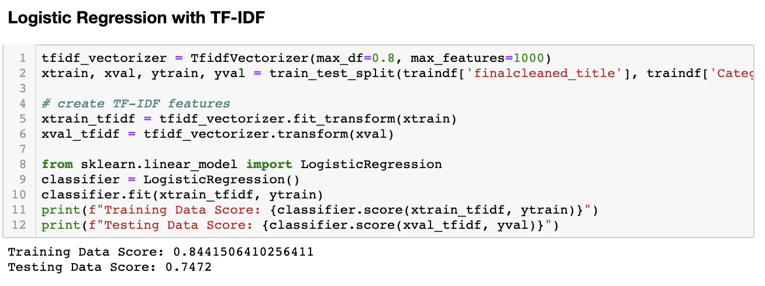
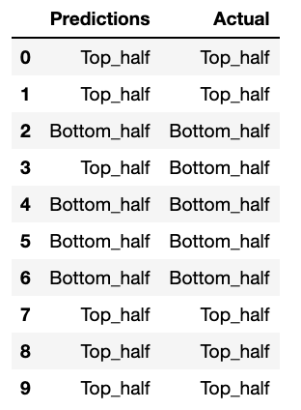
ML: Predict citation based on title using logistic regression
TF-IDF is used due to frequent appearance of words such as “RNA” and “Seq” in a genomics journal

Slide 16
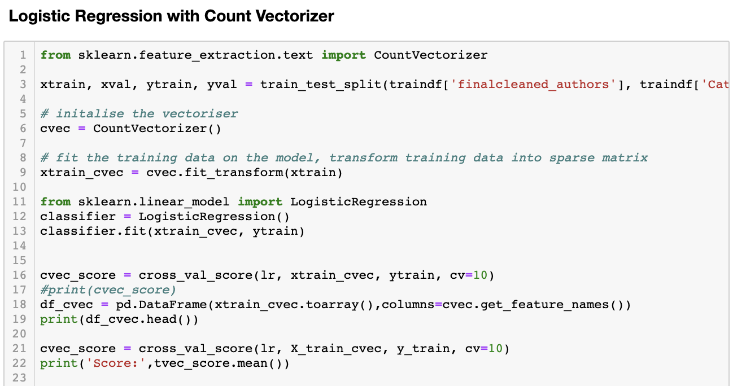
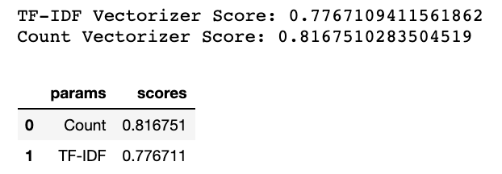
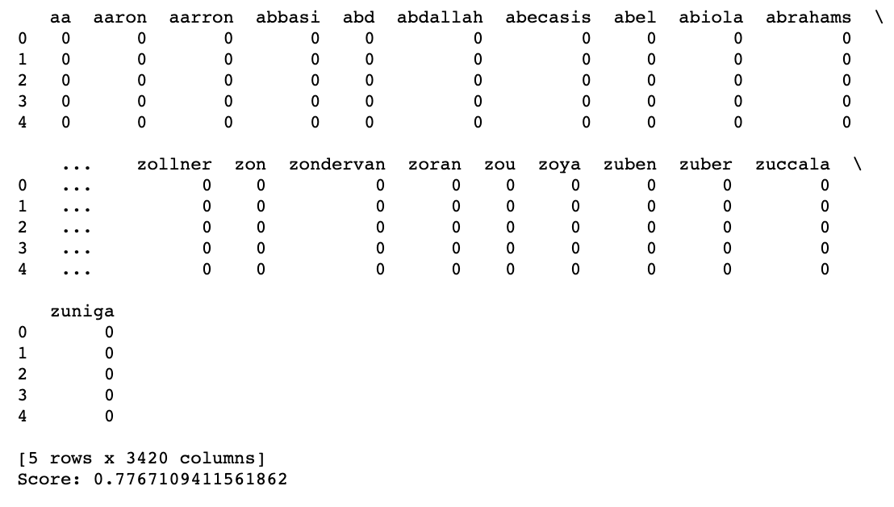
ML: Predict citation based on author using logistic regression
- Count vectorizer is used because we don’t want to discard anyone’s name…

Slide 17
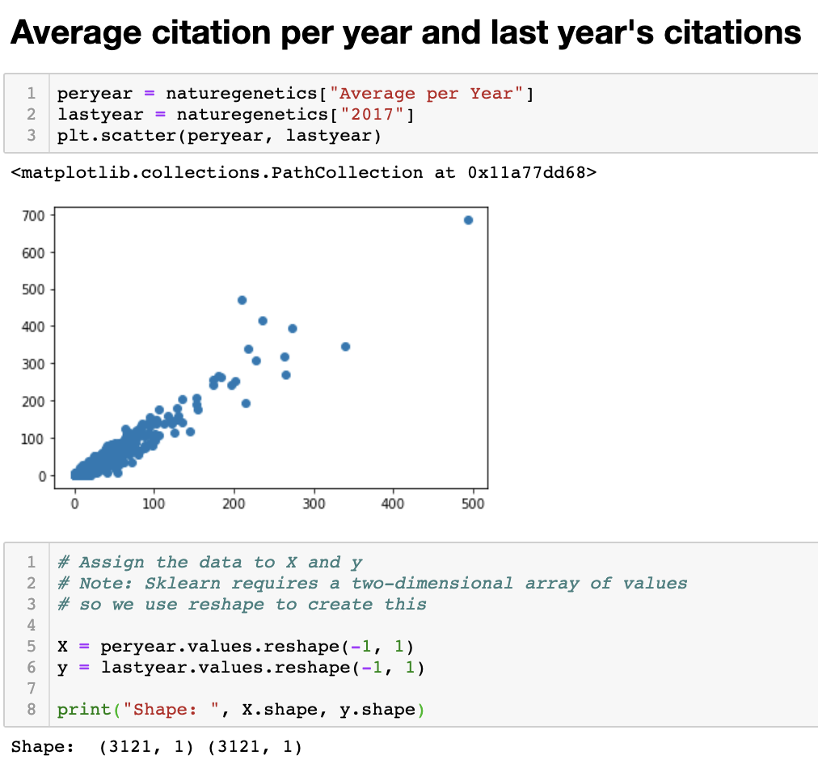
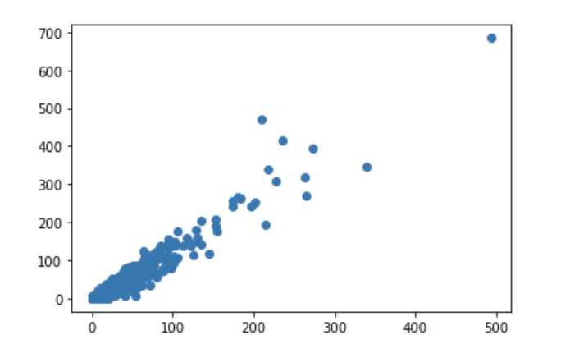
ML: Predict total citation based on previous trends using linear regression
Reshape

Slide 18
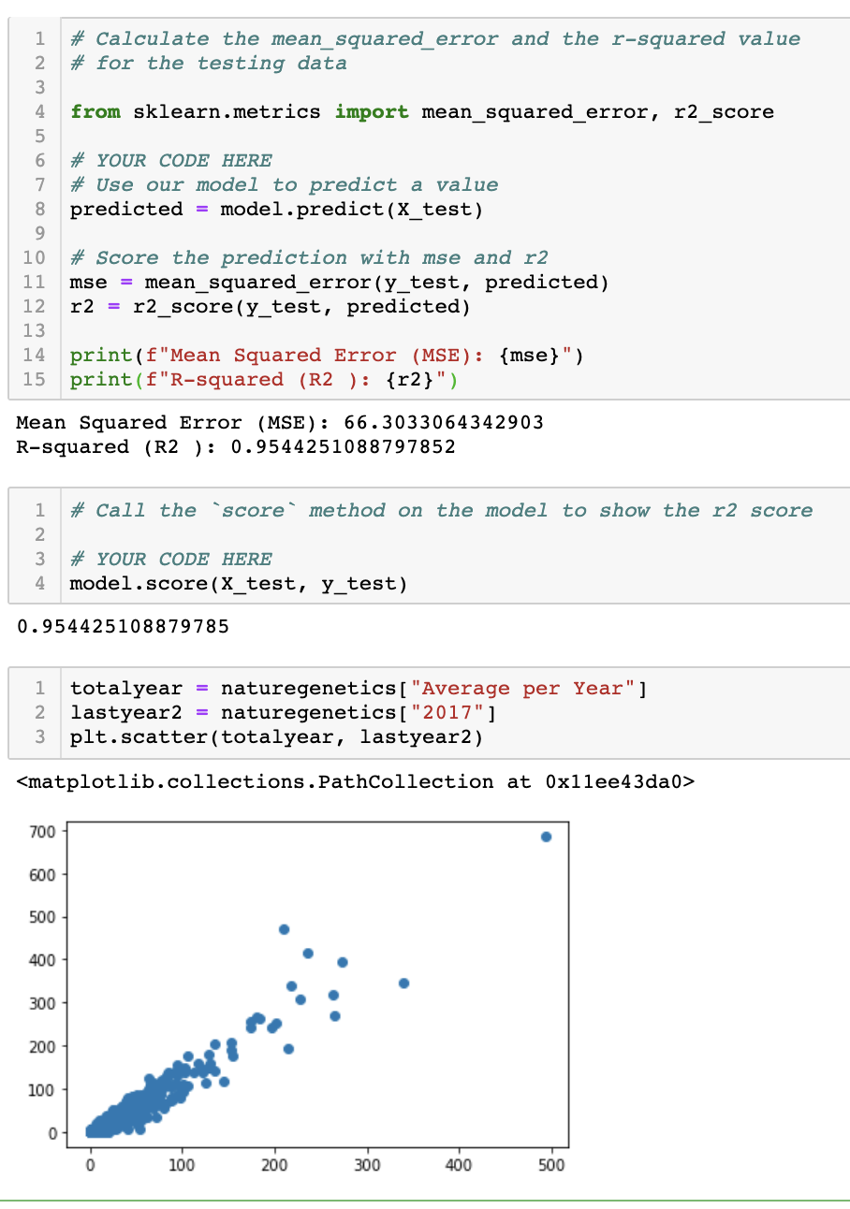
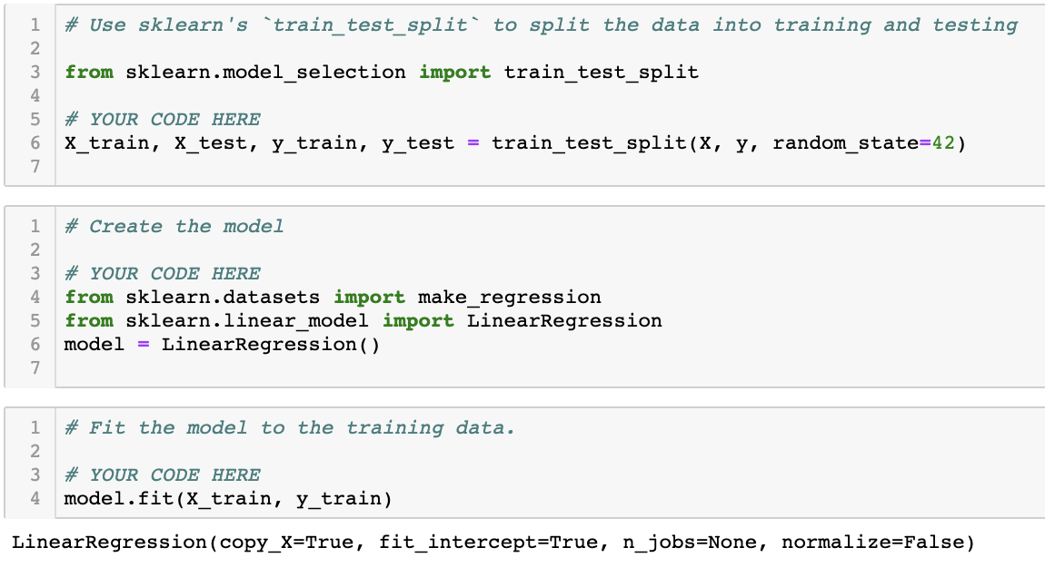
ML: Predict total citation based on previous trends using linear regression

Slide 19
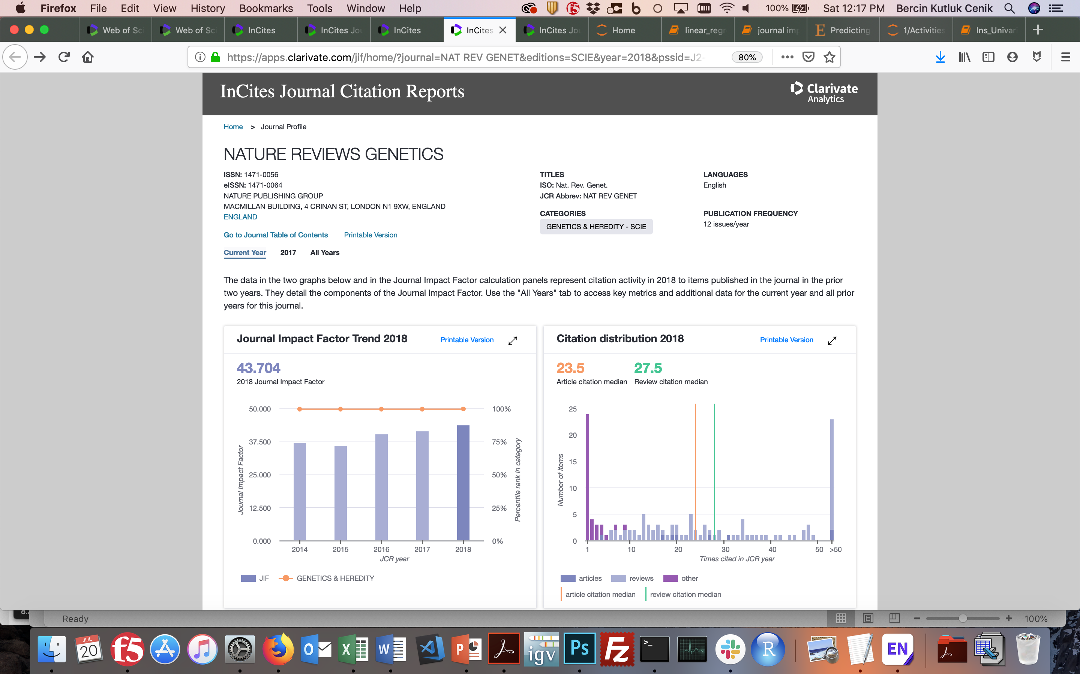
Data Source
3121 articles published between 2000 to 2017
Source: Nature Reviews Genetics website

